Slide 1
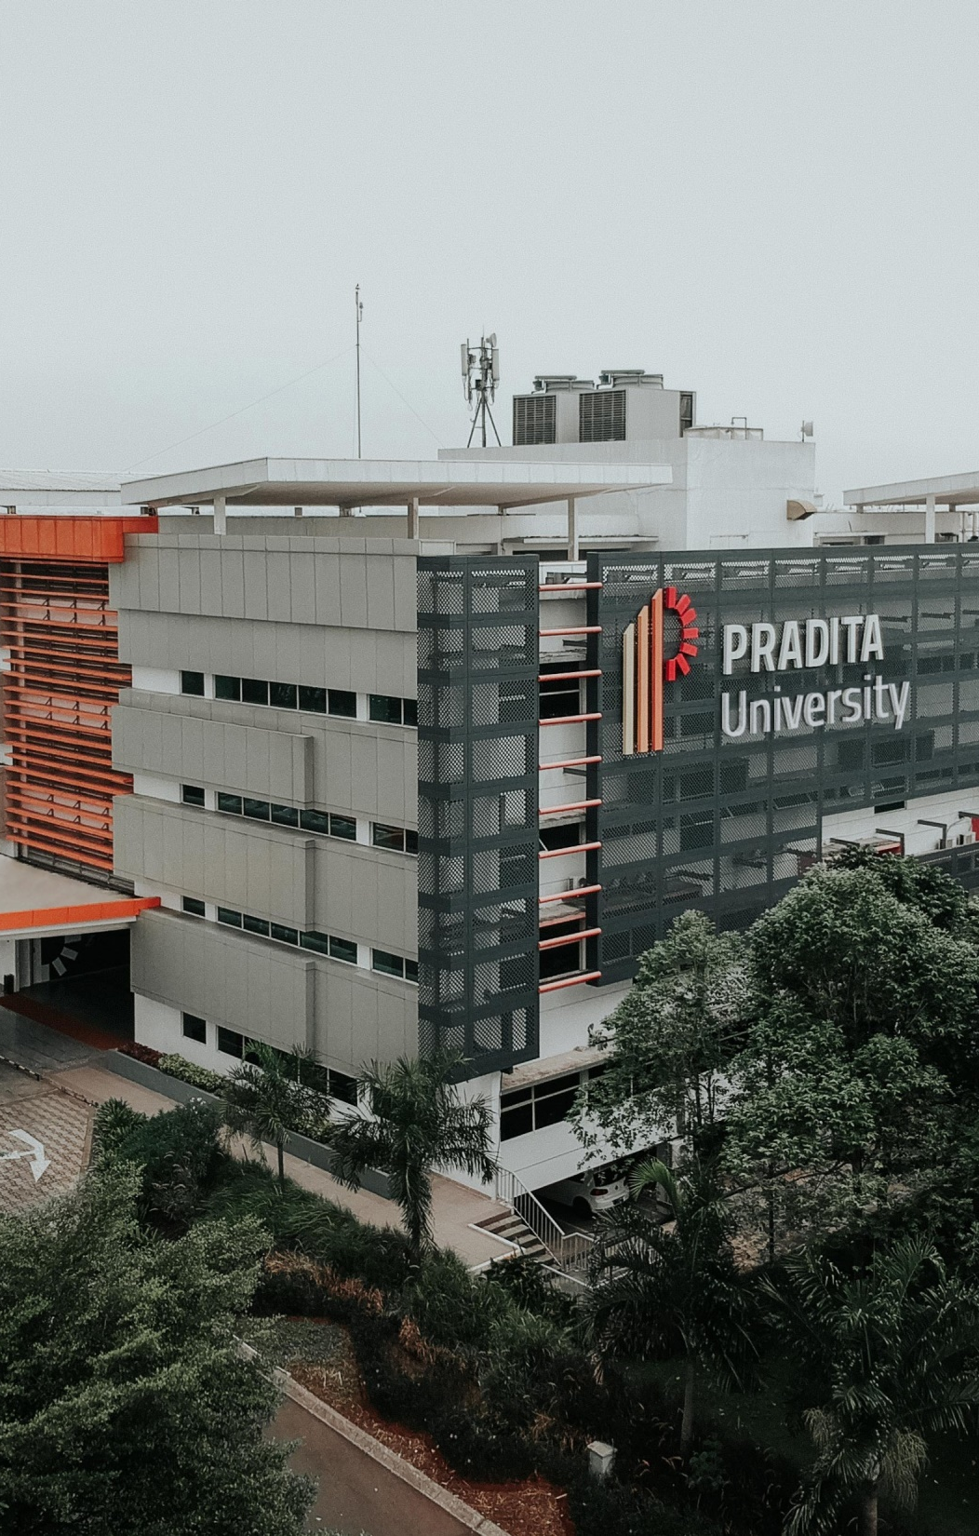
Application Component
Chapter 3

Slide 2

Introduction

Slide 3
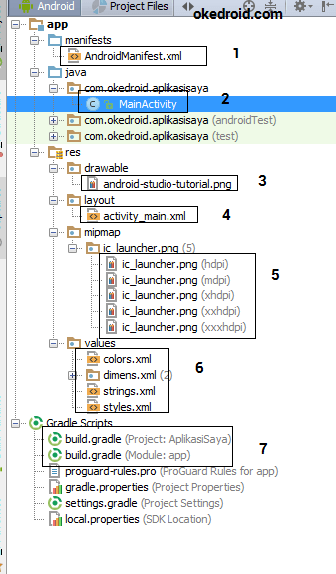
Directory Structure of Project
When the project is created, the main activity class (Main Activity) is automatically created.
The location of MainActivity.java is in the java / folder which is accompanied by a namespace, class and subclass representing the main activity.
The application structure is divided into several elements: →

Slide 4
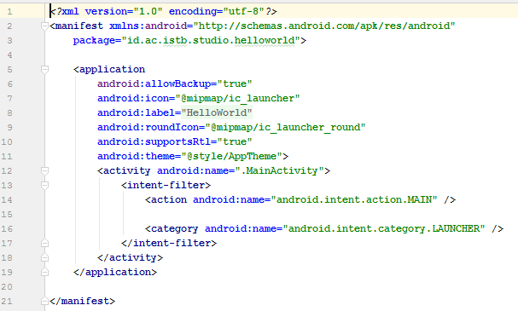
1. Manifest
The manifest folder contains the AndroidManifest.xml file.
This file contains information about packages (packages) in the project, in which there are application components such as Activity, Services, User Permissions, Content Providers, etc.
If you want to create a new Activity, make sure it is in this file.
If the application requires an Internet connection, it must first fill in a User Permission.

Slide 5
Notes
<manifest>
The manifest contains the package name in the Activity class. is the root element in the AndroidManifest.xml file.
<application>
Application is a sub element of manifest. This is where the Application declaration, such as icon, application title, theme style.
android: allowBackup: to allow applications to restore the infrastructure
android: icon: launcher icon declaration of all Application components.
android: label: declare the title names of all Application components.
android: theme: theme declaration of all Application components.
<activity>
Activity here is a sub element of the application, which contains a place to register new Activities.
android: name: declares the name of the Activity class.

Slide 6

Manifest file in Android

Slide 7

Practice Manifest
Create 2 new activities, name them: SecondActivity, ThirdActivity
Look at the manifest file
Run it with the SecondActivity scenario being the first activity seen by the user
What can you learn ?
https://stylesubstancesoul.com/helpful-tips-for-students/how-can-you-learn-something-new/

Slide 8
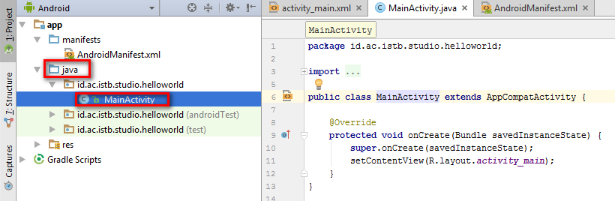
2. Java (app/packagename/MainActivity.java)
In the second folder, Java, which contains the package name containing the Java Activity class file, which we can take for example : MainActivity.java.

Slide 9
Notes
package = groups the Java Activity class files in the application.
import = to import libraries for Application components.
public class MainActivity extends AppCompatActivity = public class is a modifier used in Java programming to declare that the class / method / attribute can be accessed by other classes.
Main Activity is the name of the class and extends AppCompatActivity, stating that the Main Activity class will inherit the properties of a library named AppCompatActivity, which is a java program inheritance.

Slide 10
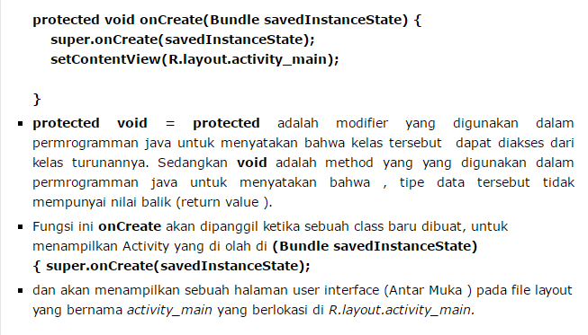

Slide 11
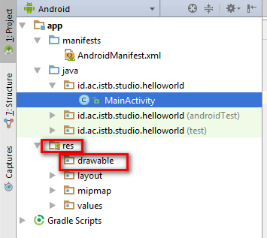
3. Resource (app/res/drawable/imagefile)
The third folder is the drawable folder, which is the contents of the resource folder.
The drawable folder is used to store image files in .jpg or .png format.

Slide 12
Practice Drawable
Take a picture
Copy paste to drawable
Create an imageView in the layout
What can you learn ?
https://stylesubstancesoul.com/helpful-tips-for-students/how-can-you-learn-something-new/

Slide 13
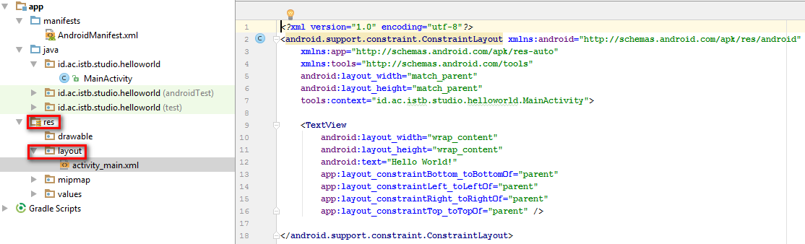
4. Resource (app/res/layout/activity_main.xml)
The fourth folder is layout, which is the contents of the resource folder.
The layout folder is used to store layout files which are the place to create User Interface components.

Slide 14
Notes
<LinearLayout>
Linearlayout is a type of layout in Activity
<TextView>
Textview is a widget of the User Interface component that is used to display text messages.
Widget ini memiliki atribut seperti :
android: layout_width and android: layout_height are one type of placement of widgets.
android: textAppearance = attribute used to display text size
android: text = contains text that will appear on the screen.
android: id = the identity of the textview widget, which will be called during programming in the java activity class.

Slide 15
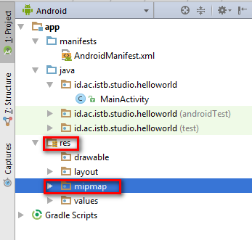
5. Resource (app/res/mipmap/ic_launcher)
mipmap is the contents of the resource folder.
The mipmap folder is used to store files, the application launcher icon named ic_launcher.

Slide 16
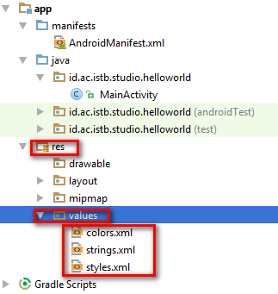
6. Resource (app/res/values)
The sixth folder is values, which are the contents of the resource folder.
The values folder is used to store files such as string.xml, styles.xml, and color.xml.
string.xml contains text resource data that will be used for Application components.
styles.xml contains theme resources such as Toolbar, which will be used for the Application component.
color.xml. contains the colors resource from styles.xml file.

Slide 17
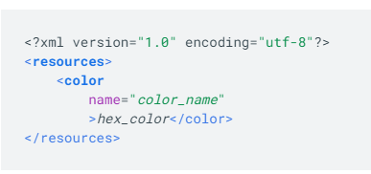
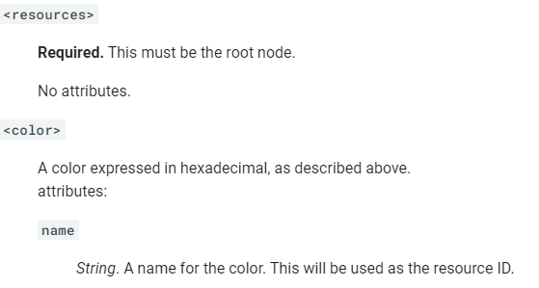
Color.xml
Syntax :
Elements :
https://developer.android.com/guide/topics/resources/more-resources#Color

Slide 18
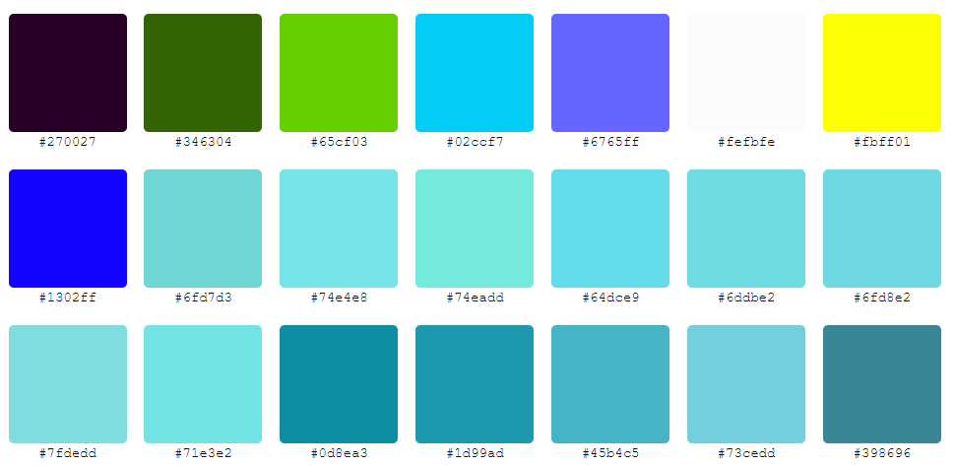
Color Codes
https://www.color-hex.com/

Slide 19
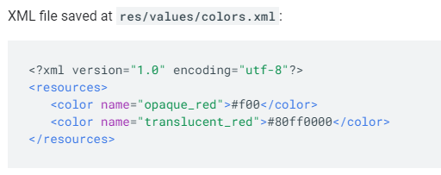
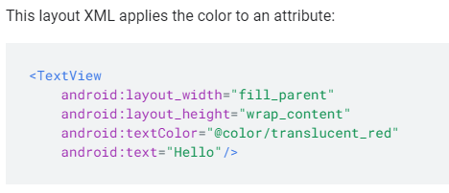
Example: Color.xml
https://developer.android.com/guide/topics/resources/more-resources#Color

Slide 20
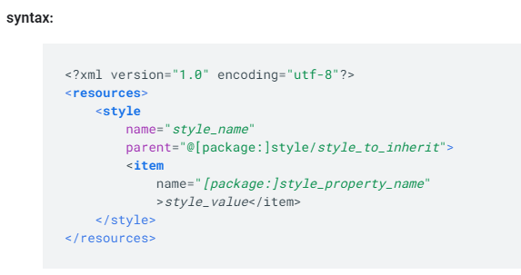
Styles.xml
A style resource defines the format and look for a UI. A style can be applied to an individual View (from within a layout file) or to an entire Activity or application (from within the manifest file).
https://developer.android.com/guide/topics/resources/style-resource

Slide 21
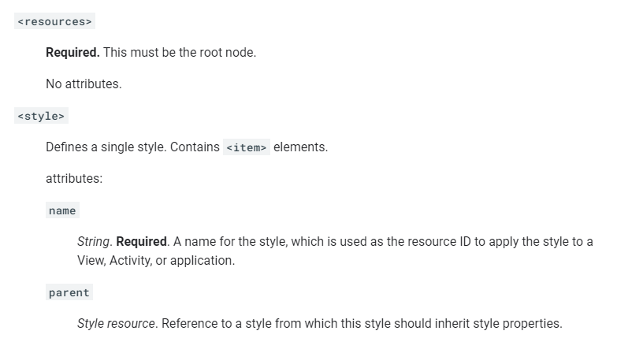
Elements Styles.xml
https://developer.android.com/guide/topics/resources/style-resource

Slide 22
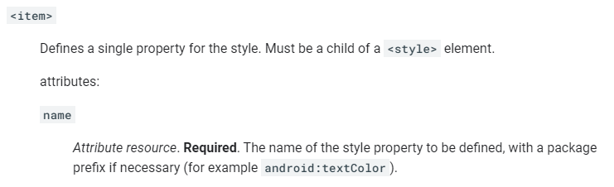
Elements Styles.xml
https://developer.android.com/guide/topics/resources/style-resource

Slide 23
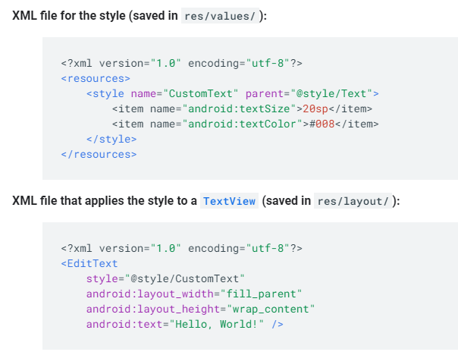
Example Styles.xml
https://developer.android.com/guide/topics/resources/style-resource

Slide 24
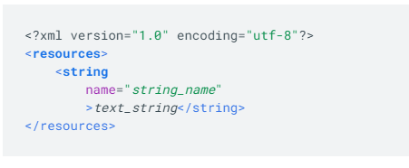
String.xml
A string resource provides text strings for your application with optional text styling and formatting.
Syntax:

Slide 25
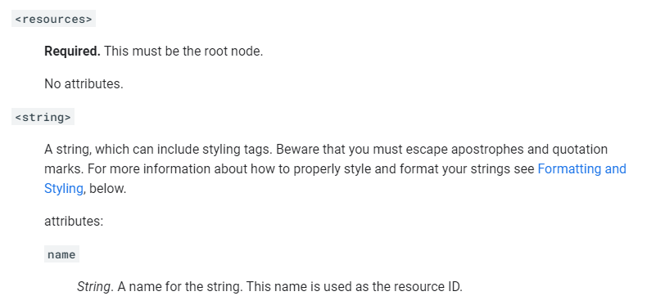
Elements String.xml
https://developer.android.com/guide/topics/resources/string-resource

Slide 26
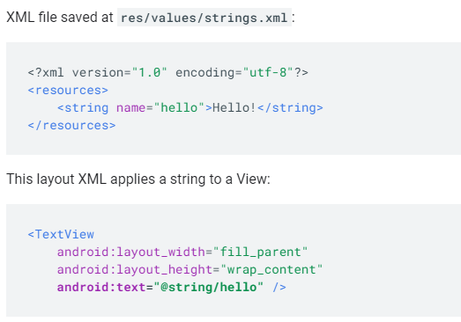
Example String.xml
https://developer.android.com/guide/topics/resources/string-resource

Slide 27

string.xml, color.xml, style.xml Implementation

Slide 28
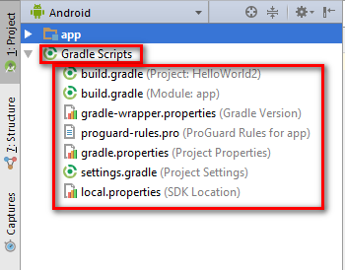
7. Gradle
Gradle is a build tool used in Android Studio, to compile the Application project to be created.
If the Eclipse build tools used are Ant.
In build.gradle it is used to identify the OS version, SDK, library that will be used in the application.

Slide 29
References
http://www.okedroid.com/2016/03/pengenalan-stuktur-folder-project-di-android-studio.html
https://developer.android.com/studio/run/emulator
https://developer.android.com/guide/topics/resources/style-resource
https://developer.android.com/guide/topics/resources/string-resource
https://developer.android.com/studio/intro?hl=id
https://developer.android.com/studio/build/dependencies?hl=id

Slide 30
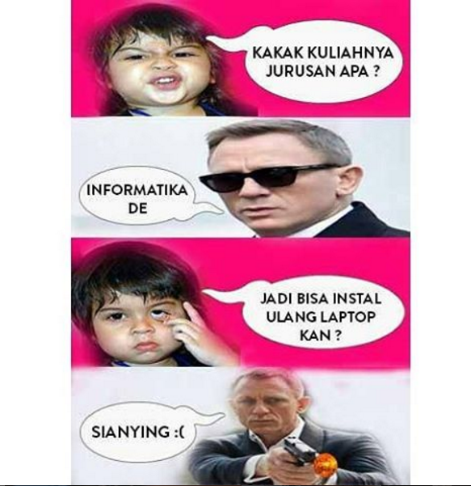
https://cdn.brilio.net/news/2016/08/01/88261/410542-12-meme-anak-programmer.png

Slide 31

Thank You
See you next week

